Slide 1

FINANCE AUTOMATION
AI Finance Co-Pilot
Month-end MIS from one Excel file: statements, variances, ageing, anomaly checks and a board pack, with AI commentary that never leaves our laptop.
DPDP-ready by design
Padam Kumar Jain
ICAI Membership - 441394
CA (India) · ACCA Affiliate (UK)
ICAI AICA L2 B 105 Mumbai – Capstone Project
Notes:
[0:00 – 0:20] OPEN
"Good morning. In the next ten minutes I'll show you a tool I built in Python that prepares our month-end MIS from a single Excel file: P&L, balance sheet, cash flow, budget variance, ageing, anomaly checks and a board pack, with management commentary written by an AI model that runs on this laptop. No data goes to the internet, and I'll show you why that matters under the new DPDP law."
Tip: keep the dashboard already open in the browser (START_DASHBOARD.bat) before you begin.

Slide 2



Month-end MIS today is a manual relay of spreadsheets
01 · WHY
STEP 1
STEP 2
STEP 3
STEP 4
STEP 5
Pull GL from ERP
Rebuild P&L, BS, cash flow
Budget variance
Debtor & creditor ageing
Write commentary, format pack
Time
Consistency
Late detection
About 2 to 3 person-days each month; pack ready by working day 5
Formulas and formats differ by preparer and by month
Duplicate payments and expense spikes are found by chance, often after close
Which steps need judgement, and which are just mechanical?
Notes:
[0:20 – 1:10] THE PROBLEM
"Every month our MIS goes through the same relay: we pull the GL, rebuild the statements in Excel, compute budget variances, prepare debtor and creditor ageing, and then write the commentary and format the pack. This takes about 2 to 3 person-days, and the pack is usually ready by working day 5."
"Because each step is manual, formulas and formats vary from month to month, and exceptions like a duplicate vendor payment are found by chance, often after books are closed."
Pause: "So I asked: which of these steps actually need judgement, and which are just mechanical? But before the solution, one point on compliance."

Slide 3

DPDP-ready by design: personal data stays on our laptop
02 · DPDP COMPLIANCE BY DESIGN
DPDP requirement | How the tool meets it
Security safeguards · s.8(5) | Names, PAN, GSTIN, bank a/c masked before the AI; data stays on the company laptop
Cross-border transfer · s.16 | None. AI runs offline and internet calls are blocked in code: stricter than the Act
Logs to detect breaches · Rules | Audit log of every run, question and report
Breach notice to Board · s.8(6) | Smaller exposure: no cloud copy; follows company incident process
Data processors | No outside AI vendor receives any data, so no processor contract
The law
DPDP Act 2023 + DPDP Rules 2025, notified 13-Nov-2025
Core duties apply from 13-May-2027
Penalty up to ₹250 Cr for weak security safeguards
Our ledgers hold personal data: individual customers and vendors, employee pay, PAN, bank details
Not a localisation mandate: transfer abroad is allowed unless to a notified country
Before go-live (IT review)
Disk encryption · 1-year log retention · user access control
Sources: DPDP Act 2023 (s.8, s.16, Schedule); DPDP Rules 2025 notified 13-Nov-2025 · not legal advice, confirm with Legal
Notes:
[1:10 – 2:10] DPDP COMPLIANCE (say this early: it removes the biggest objection to AI on finance data)
"Any AI on finance data raises one question: where does our data go?"
"India's Digital Personal Data Protection Act, 2023 and the DPDP Rules notified on 13 November 2025 apply to us. The core obligations, security safeguards, breach notification and cross-border rules, apply from 13 May 2027, about six months from now. The maximum penalty for failing to protect personal data with reasonable security safeguards is ₹250 crore."
"Our ledgers do contain personal data: individual customers and vendors such as proprietors and farmers, employee salaries and claims, PANs and bank details."
"This tool was designed for that. Security safeguards: names, PAN, GSTIN and bank numbers are masked before the AI sees anything, and data stays on the company laptop. Cross-border: there is none, because the AI runs offline and internet calls are blocked in code. Every run is logged. And no outside AI company receives our data, so there is no processor to contract with."
"To be precise: the DPDP Act itself is not a data localisation law. It allows transfers abroad unless the Government blocks a country, and sector rules like RBI's can be stricter. We go further than the Act requires by keeping everything in-house."
"Three items remain for IT before go-live: disk encryption, a one-year log retention setting and user access control."
If pressed on legal detail: "I'd confirm the final position with Legal; this slide is the design intent, not a legal opinion."

Slide 4

One Excel file in, a complete MIS pack out
03 · WHAT THE TOOL DOES
P&L, Balance Sheet, Cash Flow
Budget vs Actual
INPUT
Monthly + YTD (Apr–Mar FY)
Favourable / adverse flags
MIS_Input.xlsx
Ratios & ageing
Anomaly checks
GL sheet
Budget sheet
Ledger mapping
Margins, DSO, DPO, AR/AP buckets
Duplicates, spikes, large entries
3-month forecast
AI commentary + board pack
Revenue and projected P&L
11-sheet Excel and PDF
Notes:
[2:10 – 2:50] WHAT IT DOES (brisk)
"The tool takes one Excel workbook with three sheets: the GL export, the budget, and a ledger mapping that says which ledger is revenue, COGS, receivables and so on."
"From that it produces six things automatically: monthly and YTD statements on the April–March year; budget versus actual with favourable/adverse flags; ratios and debtor/creditor ageing; anomaly checks; a three-month forecast; and an AI-written commentary with an 11-sheet Excel pack and a PDF board pack. The numbers take seconds; the AI text about a minute."

Slide 5
Five layers, all in Python, all on this laptop
04 · HOW I BUILT IT
1 · Ingest
2 · Validate
3 · Finance engine
4 · Local AI
5 · Report
Read Excel / Tally / SAP
Check before compute
Every number
Words only
Pack & dashboard
Auto-recognises ERP column names
TB tallies, vouchers balance, every ledger mapped
Statements, variance, FIFO ageing, ratios, forecast, anomalies
Commentary and Q&A from a model running offline
Excel MIS, PDF board pack, browser dashboard
pandas · openpyxl
Python rules
pandas · numpy
Ollama · Qwen 2.5
openpyxl · reportlab · Streamlit
Free, open-source libraries · 16 automated tests pass before every run · no licence cost
Notes:
[2:50 – 3:40] HOW I BUILT IT (one sentence per layer)
"Five layers, designed like a control process. Ingestion reads Excel, CSV or Tally XML and recognises ERP column names. Validation checks the trial balance, every voucher and every ledger mapping before anything is calculated; if not, it stops. The finance engine, plain Python, calculates every number: same input, same output. The AI layer, Qwen 2.5 via Ollama, runs offline and writes only the words. Reporting produces the Excel MIS, the PDF board pack and a dashboard."
"All libraries are free and open source, and 16 automated tests run before every month's run."

Slide 6






Python calculates. The AI only writes.
05 · WHY THE NUMBERS CAN BE TRUSTED
Validation gate
Numeric & completeness guards
TB mismatch, unbalanced voucher or unmapped ledger stops the run, with a list of what to fix
AI text with any figure not in Python's facts, or a missing row, is rejected; Python's answer is used
Data stays here
Names masked
AI runs offline; internet calls blocked in code, so no cross-border transfer (DPDP s.16)
Customers and vendors become Party_001…; PAN, GSTIN, bank details masked before the AI
Audit trail
Read-only Q&A
Every run, question and report logged with time and user
Questions run as read-only queries; the query is shown with every answer
Notes:
[3:40 – 4:50] CONTROLS (the slide management will care about most)
"As an auditor my first concern with AI was: can it make up numbers? So the tool follows one rule: Python calculates, the AI only writes. Six controls make that real:
1. A validation gate: if the TB doesn't tally, a voucher doesn't balance or a new ledger isn't mapped, the run stops and tells us exactly what to fix. No wrong report is produced.
2. Numeric and completeness guards: every number the AI writes is checked against Python's figures, and if it drops or reorders a customer in a list, its answer is replaced by Python's. In testing the small model once wrote a wrong year and once left out a customer; both were caught.
3. Data stays here: the AI runs offline and the code blocks internet calls. That's the DPDP point from slide 3.
4. Party names, PAN, GSTIN and bank details are masked before the AI sees anything.
5. Every run is logged.
6. Questions to the data run as read-only queries and the query is shown with every answer."

Slide 7




Our only job: put the data in Excel
06 · EVERY MONTH FROM NOW ON
1
2
3
Fill the template
Save in “input”
Double-click RUN_MIS
Paste the GL export into the GL sheet and the budget into Budget. New ledger? Add one row in Mapping (dropdown).
e.g. MIS_Input_Oct-2026.xlsx in the tool's input folder
About 2 minutes later the month's folder opens: Excel MIS, PDF board pack, AI commentary, run summary
If something is wrong, the run stops and opens VALIDATION_ERRORS.txt, e.g. “1 ledger not in mapping: Plant & Machinery – New Line”. Fix the row, run again.
Notes:
[4:50 – 5:40] THE FUTURE PROCESS (key message)
"Going forward, the team's only job is to put the data into one Excel template. One: paste the GL export and the budget; if a new ledger was opened, add one row in Mapping from a dropdown. Two: save it in the input folder. Three: double-click RUN_MIS. About two minutes later the month's folder opens with the Excel MIS, the PDF board pack, the AI commentary and a run summary."
"If the data has a problem, for example a new ledger nobody mapped, the tool does not guess. It stops and tells us exactly which ledger to map. I've tested that."
Transition: "Let me show you." → switch to the browser.

Slide 8
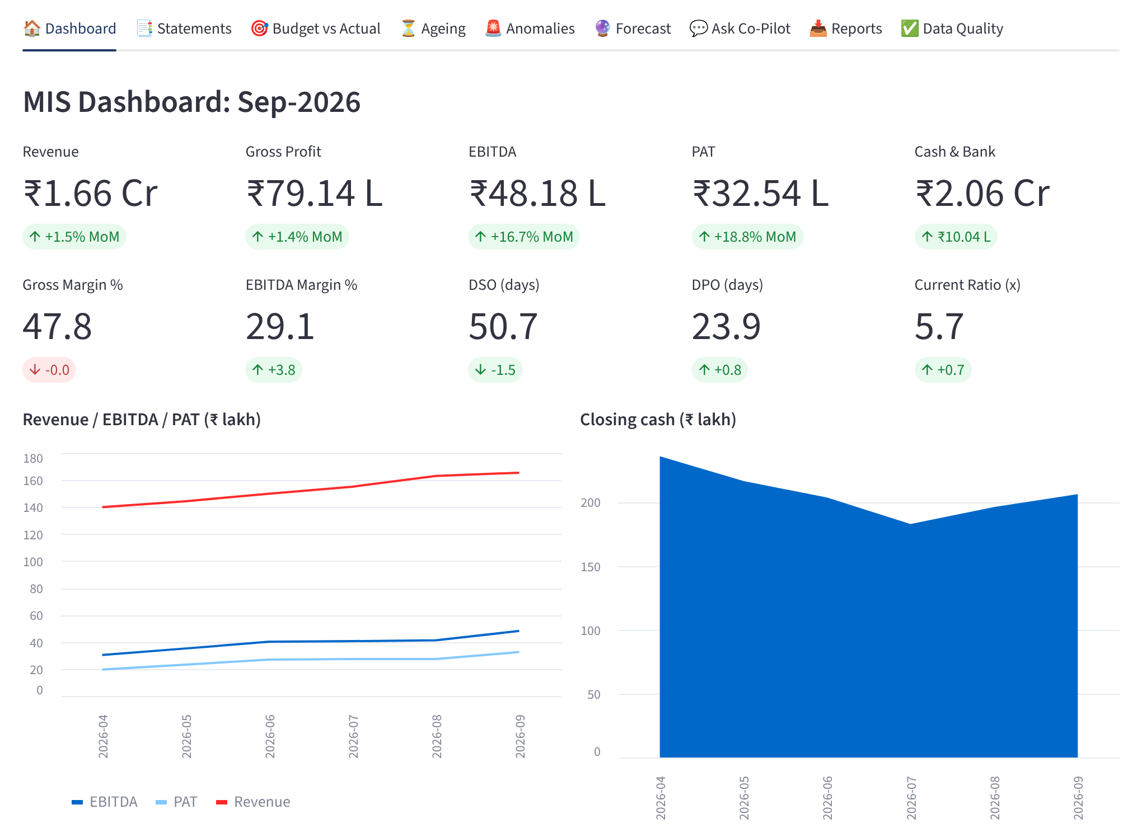
Upload the workbook, click Run, read the dashboard
07 · LIVE DEMO
1
Choose “Excel template (1 file)” and upload MIS_Input_Test_500_Lines.xlsx
2
Click Run analysis: KPIs, trends, AI commentary
3
Open Anomalies: the ₹11.50 L duplicate payment
4
Ask Co-Pilot “Which customers have the highest overdue receivables?”
5
Reports Download the Excel + PDF board pack
Notes:
[5:40 – 7:25] LIVE DEMO (about 1¾ minutes, dashboard already open)
1. Sidebar → "Excel template (1 file)" → upload input\MIS_Input_Test_500_Lines.xlsx. Say: "This is the only input: 500 GL lines and 60 budget lines for a test company, April to September 2026."
2. Run analysis (≈1–1.5 min with AI on; talk while it runs: "Python finishes in seconds; the rest is the AI writing"). Point at Sep-2026: revenue ₹1.66 Cr, EBITDA ₹48.18 L (29.1%), PAT ₹32.54 L, cash ₹2.06 Cr.
3. Anomalies tab: "It flagged ₹11.50 lakh paid twice to Sunrise Packaging two days apart, and professional fees of ₹7.25 lakh in August, 867% above the normal month. Found automatically, before close."
4. Ask Co-Pilot: "Which customers have the highest overdue receivables?" → Deccan Food Distributors ₹62.39 L over 60 days. Show the SQL underneath.
5. Reports tab → Generate MIS pack → show the PDF briefly.
BACKUP: open output\2026-09\MIS_2026-09.pdf. If Ollama is slow, switch off "Use local LLM"; rule-based commentary appears in seconds.

Slide 9
Tested on a 500-line ledger with an answer key
08 · HOW WE TESTED IT
What was checked | Result
Trial balance: Dr = Cr | ✓ ₹44,72,38,004.21
Balance sheet and cash-flow check rows | ✓ zero every month
Closing bank vs answer key | ✓ match, 6 of 6 months
GST, TDS, tax provision, term loan balances | ✓ agree to the rupee
Income tax @25.168% of monthly PBT | ✓ e.g. ₹6,58,813.34 on ₹26,17,662.67
Bank balance never negative | ✓ lowest ₹1.18 Cr
Planted errors detected | ✓ 3 of 3
500
60
GL lines, Apr–Sep 2026
budget lines (10 a month)
199
78 / 78
vouchers, every one balanced
P&L cells match the answer key
Planted errors: duplicate payment, professional-fee spike, slow-paying customer · synthetic company: Sample Foods Pvt Ltd
Notes:
[7:25 – 8:10] HOW WE TESTED IT
"Before trusting it, I built a separate test ledger: exactly 500 GL lines in 199 vouchers and 60 budget lines, for a test company from April to September 2026, with GST, TDS, depreciation, a term loan, inventory adjustments and monthly tax provisions, like a real ledger."
"The workbook carries its own answer key, calculated independently. The tool matched all 78 P&L figures to the paisa; the balance sheet and cash flow balance every month; GST, TDS and loan balances agree; and the tax provision is exactly 25.168% of PBT, the section 115BAA rate."
"I also planted three errors for it to find: a duplicate payment, a fee spike and a slow-paying customer. It found all three."

Slide 10
Sep-2026 and H1 FY 2026-27 from the 500-line file
09 · TEST RESULTS
Revenue Sep-26
EBITDA
PAT
Closing cash
₹1.66 Cr
₹48.18 L
₹32.54 L
₹2.06 Cr
−2.4% vs budget
29.1% margin
H1: ₹1.57 Cr
DSO 51 · DPO 24 days
Exceptions found automatically
Finding | Amount | Detail
Duplicate payment (Jul) | ₹11.50 L | Same vendor, 2 days apart
Professional fees (Aug) | ₹7.25 L | 867% above normal month
Overdue > 60 days | ₹62.39 L | Deccan Food Distributors
H1 EBITDA vs budget | −17.8% | Admin +15.8%; unbudgeted loan
Synthetic test data · Sample Foods Pvt Ltd
Notes:
[8:10 – 8:40] RESULTS (skip quickly if the demo already showed them)
"On the test file, September revenue is ₹1.66 crore, 2.4% below budget; EBITDA ₹48.18 lakh at 29.1%; PAT ₹32.54 lakh; closing cash ₹2.06 crore. For the half-year, revenue is ₹9.18 crore and PAT ₹1.57 crore."
"The chart shows revenue below budget every month. The exceptions came out automatically: the ₹11.50 lakh duplicate payment, the ₹7.25 lakh professional-fee month, ₹62.39 lakh overdue from one customer, and H1 EBITDA 17.8% below budget, driven by admin costs and an unbudgeted loan."
Be clear: "This is synthetic test data, not company data."

Slide 11
What it does not do yet, and how we manage it
10 · HONEST LIMITS
Limit today | Mitigation
Tested on synthetic data only | Two test sets (3,633 and 500 lines) reconcile; next, one-month parallel run on actuals
Small AI model on a laptop | Numeric and completeness guards; AI text is a draft the finance team reviews and signs off
Ledger mapping needs upkeep | Run stops on any unmapped ledger; mapping owned by the reporting team
Standalone entity, standard P&L lines | Next phase: cost centres, segments, consolidation; Ind AS adjustments stay manual
DPDP items still open | Disk encryption, 1-year log retention, access control: IT review before go-live
Notes:
[8:40 – 9:10] LIMITS (say this before they ask; it builds trust)
"It has been tested only on synthetic data: two test sets that reconcile fully. Before relying on it we should run it in parallel with our current MIS for one month."
"The AI model is small because it runs on a laptop. That's why the guards exist, and the AI commentary is a draft we review and sign off; accountability stays with Finance."
"Mapping needs upkeep, but the tool forces it. Today it handles a standalone entity; cost centres, segments and consolidation are next. And the three DPDP items, encryption, log retention and access control, need IT before go-live."

Slide 12
Approve a one-month parallel run on actual data
11 · THE ASK
PHASE 1 · [Month 1]
PHASE 2 · [Month 2–3]
PHASE 3 · [Month 4+]
Parallel run
Extend
Scale
One unit's actuals; reconcile every line with the current MIS
Cost-centre and unit MIS, direct ERP export, PowerPoint pack
Internal server, scheduled monthly run, email to CFO
Notes:
[9:10 – 9:40] THE ASK, then close
"My request is simple: approve a one-month parallel run on one unit's actual data. We prepare the MIS the normal way and with the tool, and reconcile every line."
"If it reconciles, phase two adds cost-centre and unit MIS, a direct ERP export and a PowerPoint pack; phase three moves it to an internal server with a scheduled monthly run."
"What I need: export access for one unit, an IT security review covering the DPDP safeguards, Legal's confirmation of the DPDP position, and half an hour with the reporting team on the mapping."
Close: "The goal isn't to replace judgement. It's to give the finance team back the days we spend rebuilding spreadsheets, so we can spend them on analysis. Thank you."
Fill the bracketed months before the meeting.

Slide 13
Questions management is likely to ask
APPENDIX A · FOR THE PRESENTER
Question | Short answer
Is it DPDP-compliant? Does data go to the cloud? | No data leaves the laptop: AI runs offline, PAN and names masked, every run logged (s.8(5), s.16).
Can the AI make up numbers? | Python computes every figure; AI text with a figure not in the data, or a missing row, is rejected
How do we know the numbers are right? | 500-line test file with an answer key: 78 of 78 P&L figures match; BS and cash flow balance
What did it cost? | No licence cost: free open-source software on an existing laptop, plus my time
Who maintains it if you are away? | Month-end needs only Excel and one double-click; guide and 16 tests are in the folder
Will it replace the team? | No. It removes rebuilding work; review, judgement and sign-off stay with Finance
Notes:
Longer answers if pressed:
• DPDP: "The DPDP Act 2023 and Rules notified 13-Nov-2025 apply core duties from 13-May-2027; the maximum penalty for failing reasonable security safeguards is ₹250 crore. The Act isn't a localisation law (s.16 allows transfers except to notified countries), but keeping data and the AI on our own machine avoids cross-border and processor issues entirely. Open items for IT: disk encryption, 1-year log retention, access control. Legal should confirm the final position."
• Accuracy: "On the 500-line test file, the tool matched all 78 P&L figures in the answer key to the paisa, and the balance sheet and cash flow balance every month. A parallel run on real data is what I'm asking approval for."
• Audit/governance: "Every run is logged with time, user and files; calculation rules are in code with automated tests, which is more auditable than a spreadsheet whose formulas can be overwritten."
• Bigger AI model: "With a GPU server on our own premises we could run a larger, better-writing model under the same controls."
• Time saved: give only your own measured figure from the parallel run; don't estimate before it.

